Slide 1

Visualising Prescribing Flows for New Patients with Chronic Pain
This report illustrates the prescribing patterns of all new patients with chronic pain (n = 1099) in one locality in Scotland in the 12 months after receiving their first pain prescription.

Slide 2
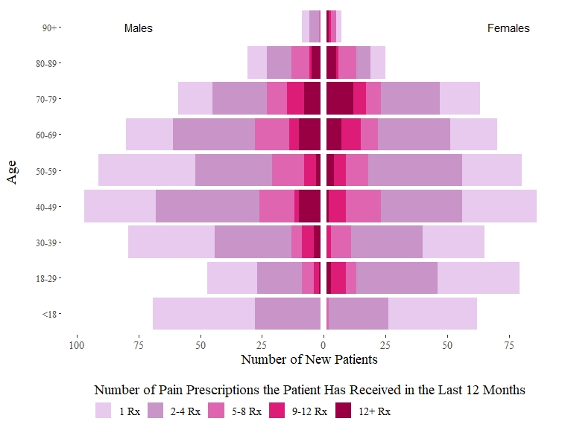
Who are the main users of pain medications by sex and age?
The number of new patients receiving at least 1 pain prescription is roughly evenly split between males and females (with slightly more males overall). A key exception, however, is for the 18-29 age group, where there are 68% more females than males. Middle-aged patients are more likely to receive pain prescriptions than younger or older groups.
This population pyramid shows the distribution of new patients with pain prescriptions by age group, starting from youngest at the bottom to oldest at the top and divided down the centre between males (left) and females (right). The hue saturation of the cells indicates the level of use, with darker shades indicating higher users (i.e., patients with more prescriptions (rx)).

Slide 3
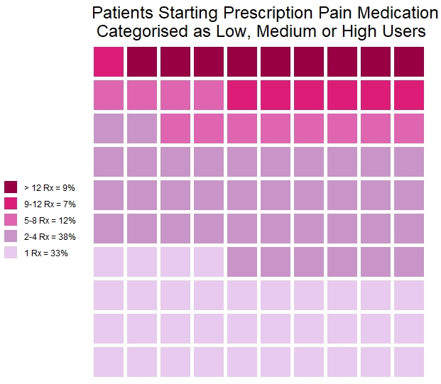
How many new patients become high users?
9% of patients in their first year after starting prescription pain medication become high users, receiving more than 12 prescriptions in 12 months. The 9% highest users receive 73% of all prescriptions.
Each cell in this 10 x 10 cell grid represents 1 percentage point, summing up to a total of 100%. The hue saturation of the cells indicates the level of use, with darker shades indicating higher users (i.e., patients with more prescriptions (rx)).

Slide 4
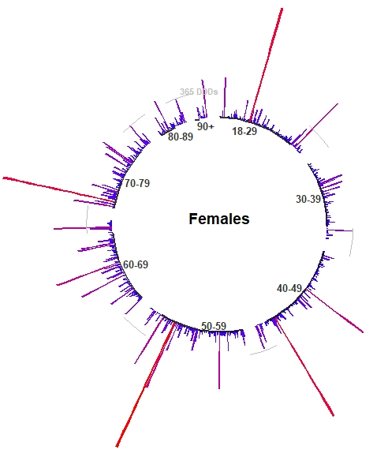
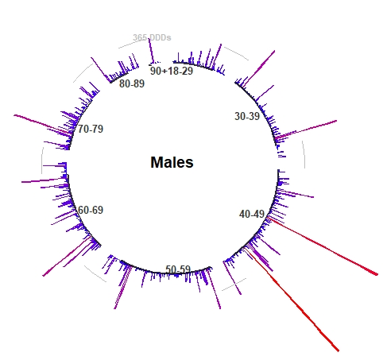
How are the extreme outliers distributed by sex and age group?
Extreme outliers are defined as patients receiving more than 365 Defined Daily Doses (DDDs) of pain medication within 365 days. Overall, extreme outliers are less likely in older age groups, and females are higher users than males.
Each line in these circular bar charts represents the total volume of pain medication prescribed per patient, with longer, redder lines indicating patients receiving higher volumes and shorter, bluer lines indicating patients with lower volumes. A grey reference line shows what 365 DDDs look like. Patients are ordered clockwise by age group from young to old.

Slide 5
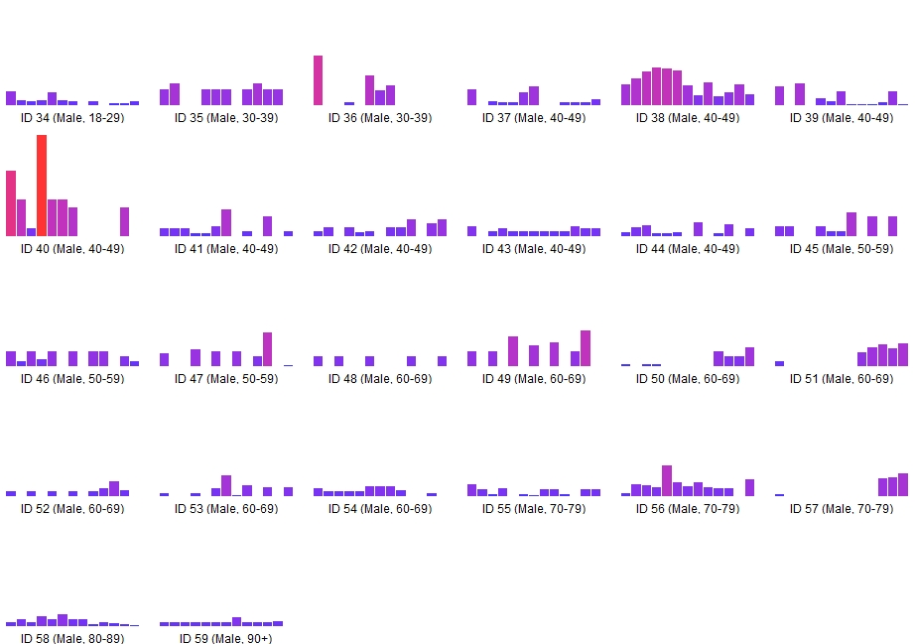
What happens after outlier patients receive their first pain prescription?
Male Outliers: Volume of Pain Medication Prescribed per Month
Most outlier patients steadily use pain medication in their first year, with few patients going more than 1 or 2 months without a prescription. Younger and middle aged males tend to receive more pain medication than older males.
This bar chart matrix shows the total volume of pain medication prescribed per month for each of the outlier patients, with each chart showing an individual patient journey. The volume of medication is represented by the height and colour gradient of the bars. Higher, redder bars include higher volumes, whereas lower, bluer bars indicate lower volumes. Gaps between prescriptions are shown by white spaces. Facets are used to split this analysis by gender and age group. Within each gender, patients are ordered from youngest to oldest.

Slide 6
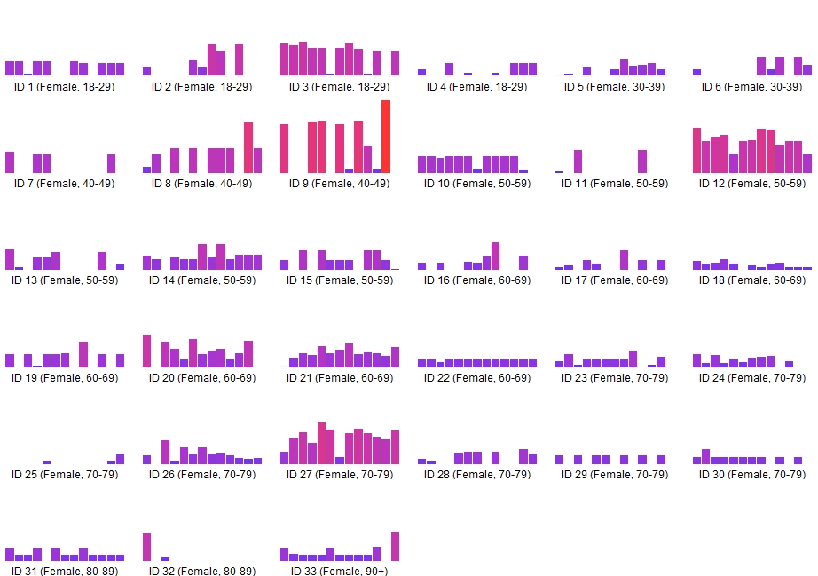
Overall, female outliers receive higher volumes of pain medication than males. Like with the male outliers, there are few monthly intervals between prescriptions.
This bar chart matrix shows the total volume of pain medication prescribed per month for each of the outlier patients, with each chart showing an individual patient journey. The volume of medication is represented by the height and colour gradient of the bars. Higher, redder bars include higher volumes, whereas lower, bluer bars indicate lower volumes. Gaps between prescriptions are shown by white spaces. Facets are used to split this analysis by gender and age group. Within each gender, patients are ordered from youngest to oldest.
Female Outliers: Volume of Pain Medication Prescribed per Month

Slide 7
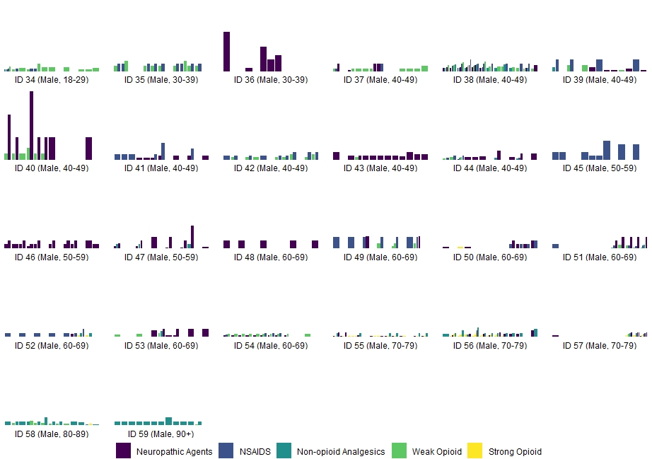
With the exception of 2 patients under the age of 50, male outliers are generally prescribed small or medium pack sizes. The majority of male outliers exhibit patterns of polypharmacy (i.e., receiving 2 or more different drug classes).
This bar chart matrix shows the sequence and pack size of pain medication prescribed for each of the outlier patients, with each chart showing an individual patient journey. Each bar represents a single pain medication prescription, with many (thinner) bars showing more prescriptions. Pack size is represented by the height of each bar, with smaller pack sizes (< 1 weeks’ worth of medication) indicated by lower bars and higher pack sizes by higher bars. Colour indicates drug class. Prescriptions are ordered from earliest to latest and grouped by month. Facets are used to split this analysis by gender and age group. Within each gender, patients are ordered from youngest to oldest.
Male Outliers: Sequence of Prescriptions by Drug Class and Pack Size

Slide 8
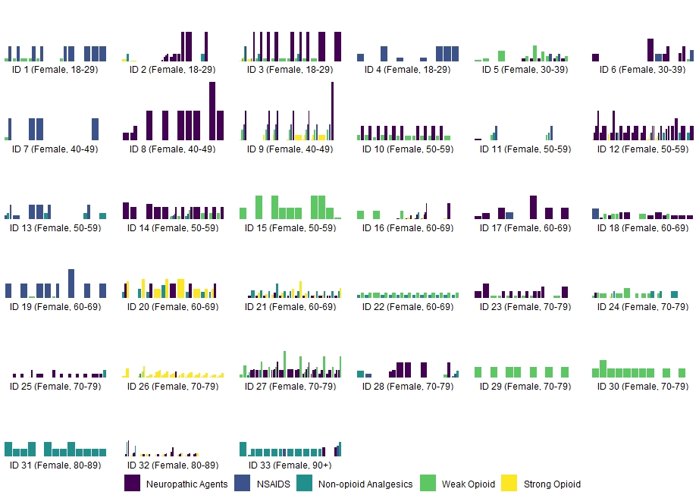
Female outliers are generally prescribed more large pack sizes than males and also tend to receive more strong opioids. About half of the female outliers exhibit patterns of polypharmacy (i.e., receiving 2 or more different drug classes). Most prescriptions for the same drug class tend to be for the same pack size.
This bar chart matrix shows the sequence and pack size of pain medication prescribed for each of the outlier patients, with each chart showing an individual patient journey. Each bar represents a single pain medication prescription, with many (thinner) bars showing more prescriptions. Pack size is represented by the height of each bar, with smaller pack sizes (< 1 weeks’ worth of medication) indicated by lower bars and higher pack sizes by higher bars. Colour indicates drug class. Prescriptions are ordered from earliest to latest and grouped by month. Facets are used to split this analysis by gender and age group. Within each gender, patients are ordered from youngest to oldest.
Female Outliers: Sequence of Prescriptions by Drug Class and Pack Size

Slide 9
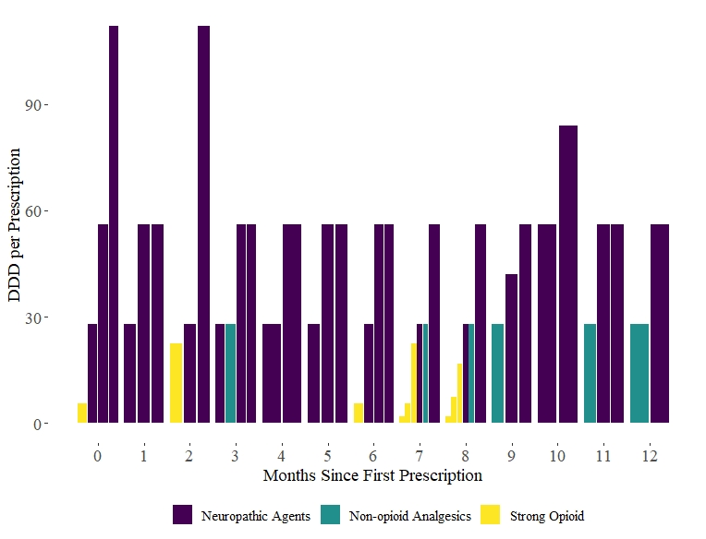
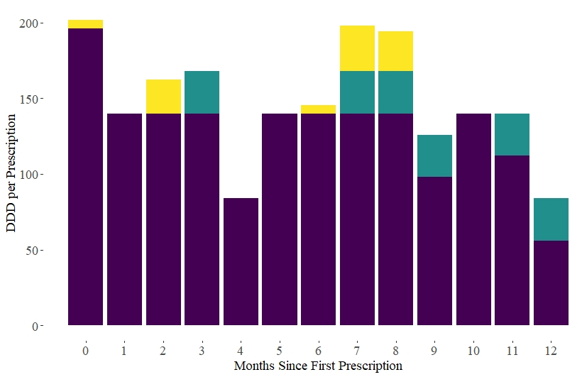
Close-up of the Largest Outlier
The highest user in our sample was a female in her 50s who cumulatively received over 5 years’ worth of pain medication in a 12 month period.
The stacked bar chart above shows the total volume of medication prescribed each month in the year following her first prescription, with the colour of the bars indicating drug class. The dodged bar chart on the right shows the volume of medication in each prescription and is grouped by month.

Slide 10
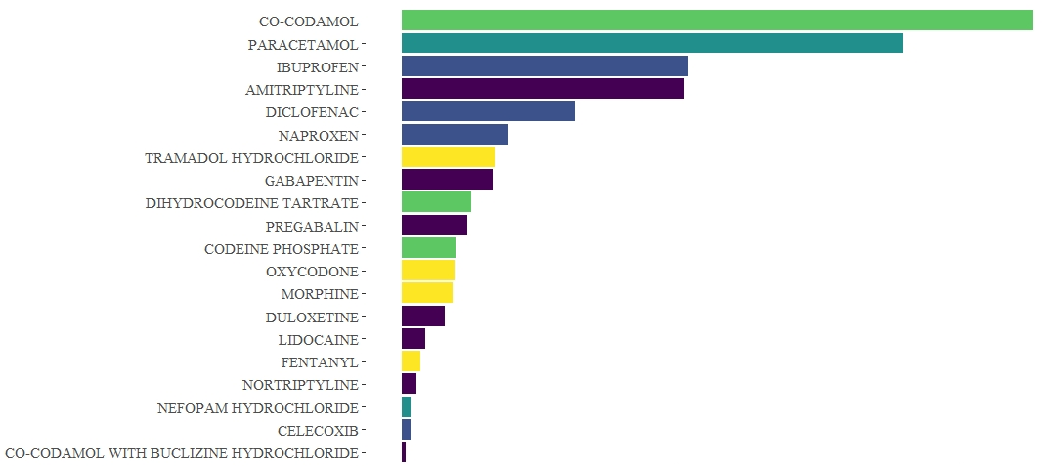
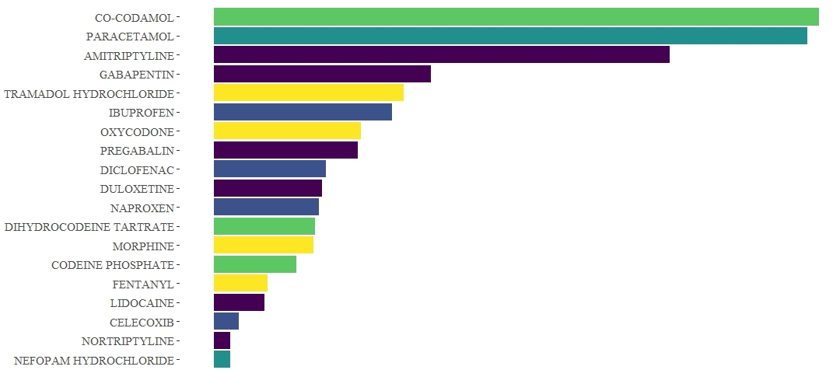
What are the most common pain medication drugs prescribed?
Co-codamol and paracetamol, which can also be purchased over the counter, are the most commonly prescribed drugs for both normal patients and outliers.
Normal Patients
Outlier Patients
These bar charts show the most common drugs prescribed for normal (left) vs. outlier (right) patients according to the number of prescriptions issued. The drug class is indicated by the colour of each bar.

Slide 11
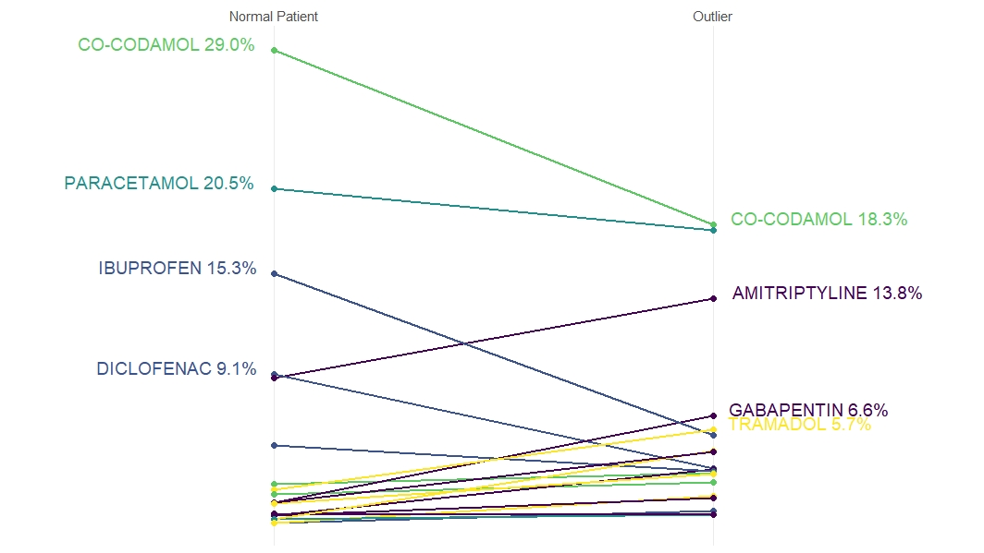
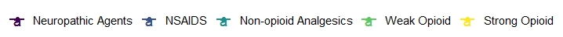
What are the main differences in drugs prescribed for normal patients vs. outliers?
Outliers receive proportionately more prescriptions for Amitriptyline, Gabapentin and for all types of strong opioids. While Co-Codamol is the most commonly prescribed drug for both groups, outliers are a third less likely to be prescribed it.
This slopegraph shows the drugs prescribed for normal patients (left) vs. outliers (right) as a percentage of all prescriptions issued for the respective group. The drug class is indicated by the colour of each line.

Slide 12
Why do people take prescription pain medication?
Injury
(broken foot)
Chronic Disease
(endometriosis)
Repetitive Strain
Palliative Care
(terminal cancer)
Arthritis / Joint Pain
Overweight / Inactive
1
2
3
4
5
6
1
2
3
4
5
Pain More Difficult to Control
Psychological
Pain Persists and No Other Management Plan in Place
Patient Sells / Gives Away Medication
Easier for GPs to Prescribe Medication Than Refer to Specialist Services
(shortage of physiotherapists and psychologists)
Reasons for Heavy Use / Overreliance on Prescription Pain Medication

